Slide 1
Introduction to Computer System
Presented by:
Kagga Devi Sri(24B91A5716)
Veerla Yasaswini(24B91A5762)
Shaik Taslima(24B91A5752)
Pasumarthi Abhiram(24B91A5745)

Slide 2
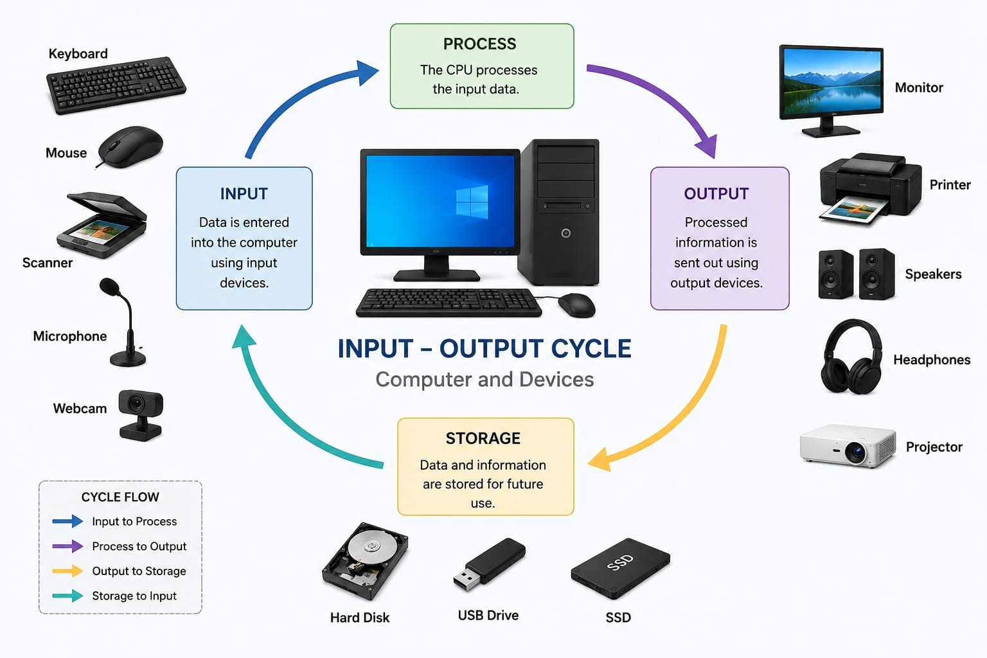
Computer System:
A computer system is an electronic device that accepts data as input, processes it according to a set of instructions (program), stores the processed information, and produces meaningful output.
IPO Cycle:
A computer works based on the Input → Process → Output .

Slide 3
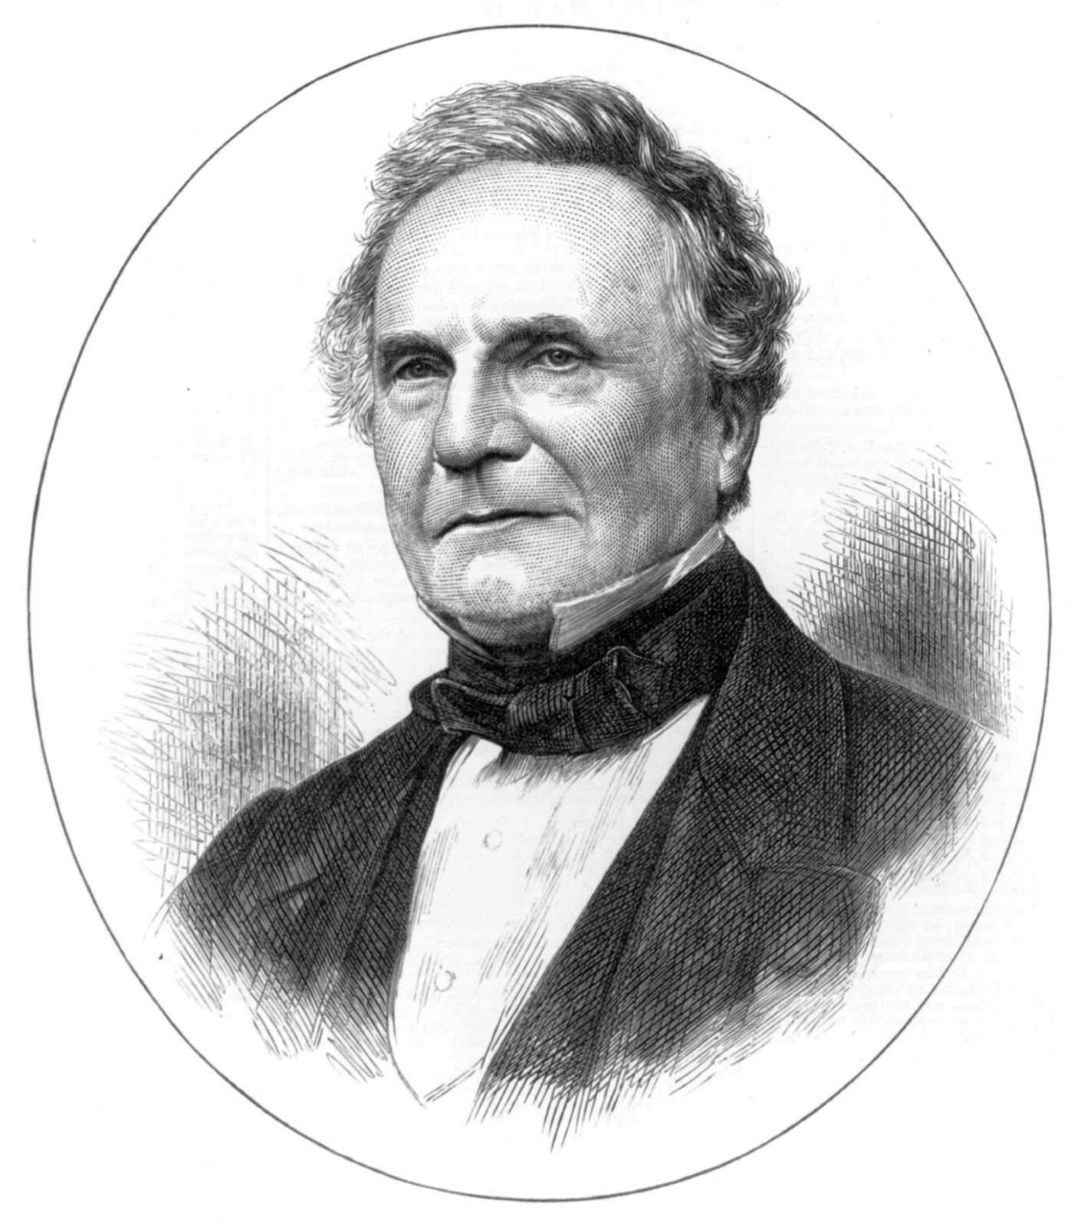
Invention of the Computer: The foundation of the modern computer was laid by Charles Babbage (1837), who designed the Difference Engine and the Analytical Engine.
Generations of the Computer:
1.First Generation
(1940–1956)
Technology: Vacuum Tubes
Ex ENIAC , EDVAC , UNIVAC-I
4. Fourth Generation
(1971–Present) Microprocessors
Ex: Desktop computer, Personal Computer and Laptop
5. Fifth Generation (Present & Future) Artificial Intelligence (AI)
Ex: AI Assistants (ChatGPT, Siri, Google Assistant) ,Self-driving Cars ,Supercomputers
3. Third Generation
(1964–1971)
Integrated Circuits (ICs)
Ex: IBM System/360 ,
PDP-8,Honeywell-6000
2.Second Generation
(1956-1963) Transistors.
Ex : IBM 1401, IBM 7094, CDC 1604

Slide 4
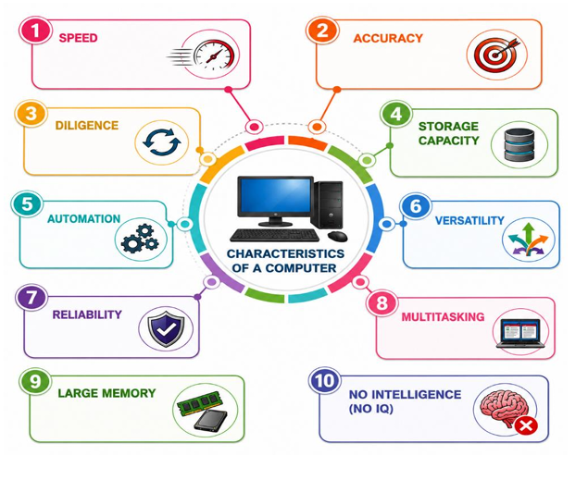
Characteristics of a Computer :

Slide 5
Where we use Computer Systems in our Daily life?
Applications of Computers
Education
Banking
Business
Entertainment
Scientific Research
Communication
Sales and finance
Agriculture
Medical
Education:
Computers support online learning, digital classrooms,
exams, and educational research.
Banking:
Computers manage customer accounts,
online transactions, ATMs, and financial records securely.
Healthcare:
Computers help maintain patient records, medical diagnosis, and support hospital management.

Slide 6
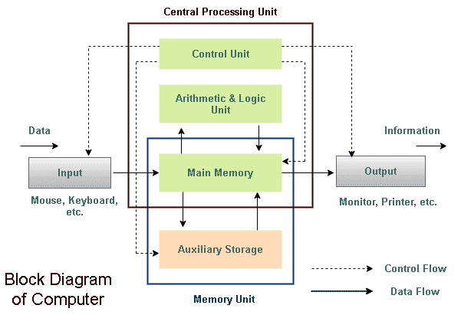
Block Diagram of Computer :
Central Processing Unit (CPU) :
The CPU is known as the Brain of the Computer.
It performs all calculations and controls the operation
of the computer. Components of CPU are
1) ALU
2) Control Unit
3) Memory Unit

Slide 7
Arithmetic Logic Unit (ALU):
The Arithmetic Logic Unit (ALU) is a part of the CPU that performs all arithmetic and logical operations. It is called the calculator of the computer because it carries out mathematical calculations and comparisons.
Control Unit (CU) :
The Control Unit (CU) is a component of the Central Processing Unit (CPU) that controls and coordinates all operations of the computer.
Memory Unit (MU):
The Memory Unit is a part of the computer that stores data, instructions, and processing results. It holds information temporarily or permanently so that the CPU can access it whenever needed.

Slide 8
Types of Memory:
Primary Memory (Main Memory) :
It is directly accessed by the CPU ,fast but has limited storage capacity and used to store data and programs currently in use.
Examples :
RAM (Random Access Memory): Temporary memory. Data is lost when the computer is turned off.
ROM (Read Only Memory): Permanent memory. Stores important startup instructions.
Secondary Memory : It stores data permanently, has a larger storage capacity than primary memory and slower than primary memory.
Examples:
Hard Disk ,
SSD (Solid State Drive),
Pen Drive (USB Flash Drive),
CD/DVD ,
Memory Card .

Slide 9
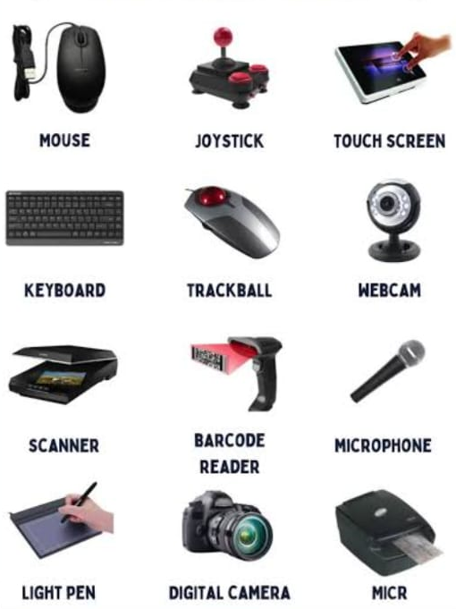
Input Devices:
Input devices are hardware components used to enter data and instructions into a computer. They help users communicate with the computer . Some of the Input devices are:

Slide 10
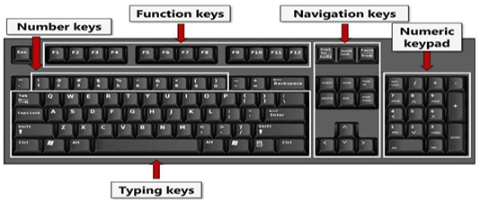
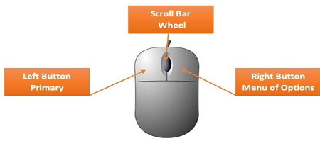
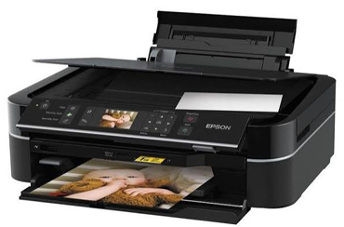
Keyboard :
The keyboard consists of alphabet keys, number keys, function keys, and special keys. It is mainly used for typing documents, entering data, and giving commands to the computer.
Mouse:
A mouse is a pointing device used to move the cursor on the screen. It helps users click, drag, scroll, and select files, folders, and other objects quickly.
Scanner:
A scanner converts printed documents, photographs, and images into digital format. It is commonly used in offices, schools, and hospitals for storing documents electronically.

Slide 11
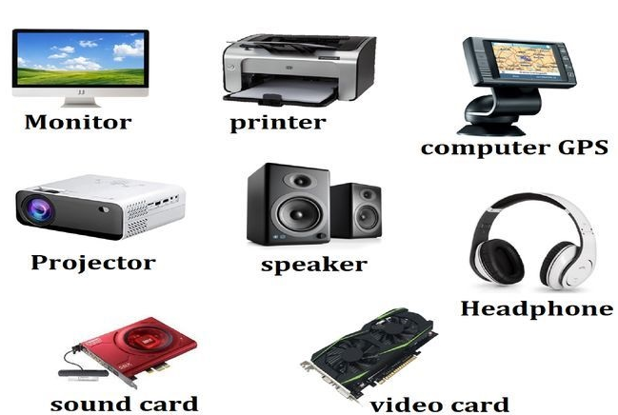
Output Devices :
Output devices are hardware components that display or produce the results of the data processed by the computer. They convert digital information into a form that users can see, hear, or use. Some of the output devices are :

Slide 12
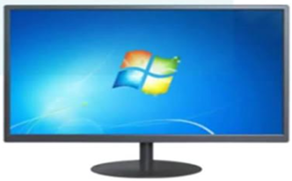
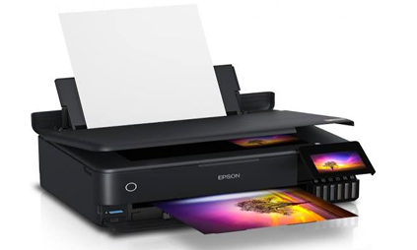
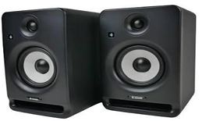
Monitor :
Displays text, images, graphics, videos, and application results on the screen. It is also called the Visual Display Unit (VDU).
Printer:
A printer produces a hard copy of documents, reports, and images on paper. Printers are commonly used in schools, offices, and businesses.
Speakers:
Speakers convert digital audio signals into sound. They are used to play music, videos, voice recordings, alarms, and system notifications.

Slide 13
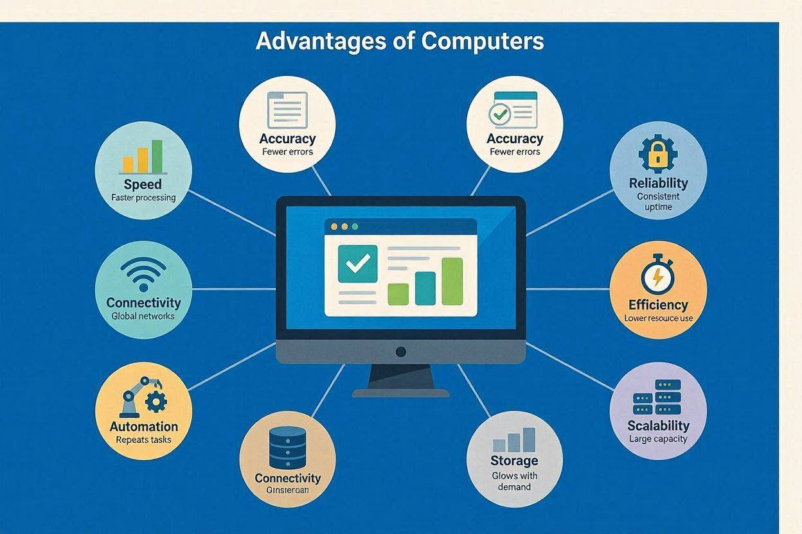
Advantages of computers:

Slide 14
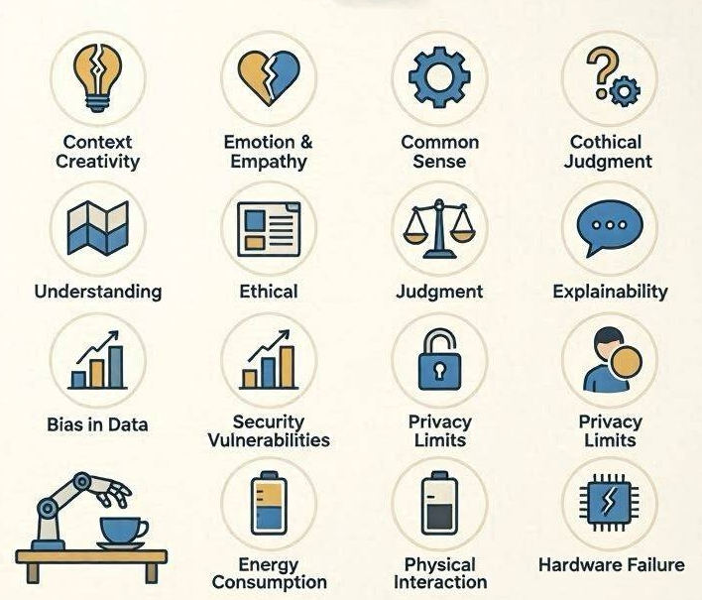
Limitations of computer:

Slide 15
Quick Assignment Session
Which of the following
is an input device?
a . Printer
b. Monitor
c. Keyboard
d. Speaker
Which characteristic allows a computer to perform different tasks?
a. Reliability
b. Versatility
c. Automation
d. Memory
Which of the following is an advantage of computers? A)They have emotions. B)They think independently.
C) They perform tasks with high speed and accuracy.
D) They never require electricity.

Slide 16
Which is an example of secondary memory? A) RAM B) ROM C) SSD D) Cache
Assignment Section
Which sector uses computers for online learning?
A) Banking B) Education
C) Entertainment D) Business
Which of the following is a limitation of computers? A) High speed B) Large storage
C) Reliability D) Cannot think independently
Which memory loses data when power is switched off? A) ROM B) RAM
C) Hard Disk D) DVD

Slide 17
Any Doubts/Queries
Thank You

